Slide 1
Biodiversity in National Parks Services Report
Why?
The scope of this project was to determine the following:
How are the species distributed?
What type of species are most like to be endangered?
Are there any correlations between species and their conservation status?
What are the largest number of species observed?

Slide 2

Biodiversity Data Analysis
Analyze Data with Python
Victor Davidov
Date: 13/08/2021

Slide 3
Introduction
Why?
The scope of this project was to determine the following:
How are the species distributed?
What type of species are most like to be endangered?
Are there any correlations between species and their conservation status?
What are the largest number of species observed?

Slide 4
1. Data Dive In

Slide 5
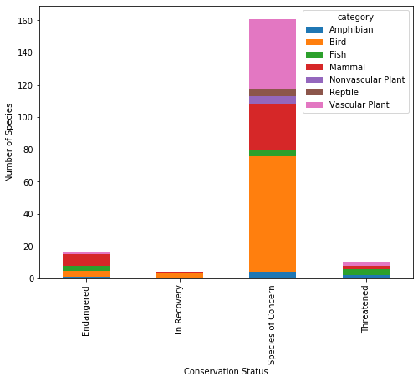
1.1 Data Sources, time period, and species by conservation status
The two csv data sources are Obeservation.csv and species_info.csv. The contain seven day period of observations data that we have used to reach our analytical goals. Some of the important facts that we have extracted are:
Number of species grouped by conservation status and Category in bar plot.
Based on the visual we can conclude that the highest number of protected species per categories is among Birds, Mammals, and Vascular Plants for that seven days period of data.

Slide 6
1.2 Species that are under protection
The below pivot summary table show the break down of each species type and protection status.
Birds, Vascular Plants, and Mammals have a higher absolute number of species protected.
category | not_protected | protected | percent_protected
Bird | 413 | 75 | 15.368852
Vascular Plant | 4216 | 46 | 1.079305
Mammal | 146 | 30 | 17.045455

Slide 7
1.3 Total number of bats observed as largest species group
The total number of bats observed in each park over the past 7 days are in the table below.
Yellowstone National Park seems to have the largest with 8,362 observations and the Great Smoky Mountains National Park having the lowest with 2,411.
Park name | Observations
Bryce National Park | 3433
Great Smoky Mountains National Park | 2411
Yellowstone National Park | 8362
Yosemite National Park | 4786

Slide 8
1.4 Total number of bats observed further drill down
Further we can see each park broken down by protected bats vs. non-protected bat sightings.
It looks like every park apart from for the Great Smoky Mountains National Park has more sightings of protected bats than not. This could be considered a hopeful sign for bats populations.
Park name | Protected | Observations
Bryce National Park | FALSE | 1596
Bryce National Park | TRUE | 1837
Great Smoky Mountains National Park | FALSE | 1299
Great Smoky Mountains National Park | TRUE | 1112
Yellowstone National Park | FALSE | 4044
Yellowstone National Park | TRUE | 4318
Yosemite National Park | FALSE | 2345
Yosemite National Park | TRUE | 2441
Bryce National Park | FALSE | 1596
Yosemite National Park | TRUE | 1837

Slide 9
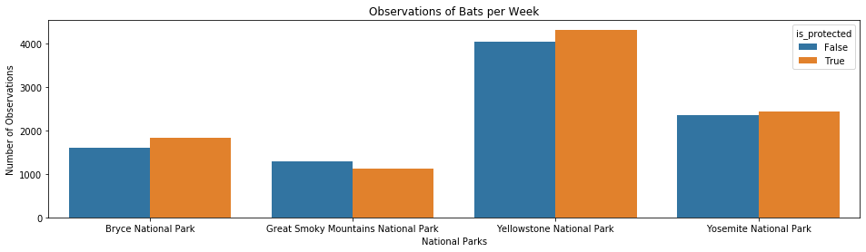
1.5 Bats sightings based on conservation status per National Parks
From this chart one can see that Yellowstone and Bryce National Parks seem to be doing a great job with their bat populations since there are more sightings of protected bats compared to non-protected species.
The Great Smoky Mountains National Park might need to beef up their efforts in conservation as they have seen more non-protected species.

Slide 10
1.6 Conclusion
The project was able to make several data visualizations and interpretations about the different species in four of the National Parks that comprised this data set for a seven days period.
This project was also able to answer some of the questions first asked at the start:
What is the distribution of conservation status for species?
Most species were not part of conservation.(5,633 vs 191)
Are certain types of species more likely to be endangered?
Mammals and Birds had the highest percentage of being in protection.
Are the differences between species and their conservation status significant?
While mammals and Birds did not have significant difference in conservation percentage, mammals and reptiles exhibited a statistically significant difference.
Which animal is most prevalent and what is their distribution amongst parks?
the study found that bats occurred the greatest number of times and they were most likely to be found in Yellowstone National Park.

